Slide 1
DATABASE

Slide 2
Olden Days

Slide 3
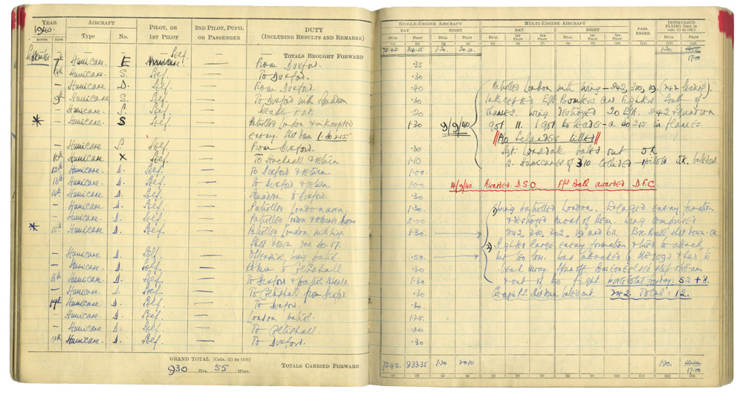

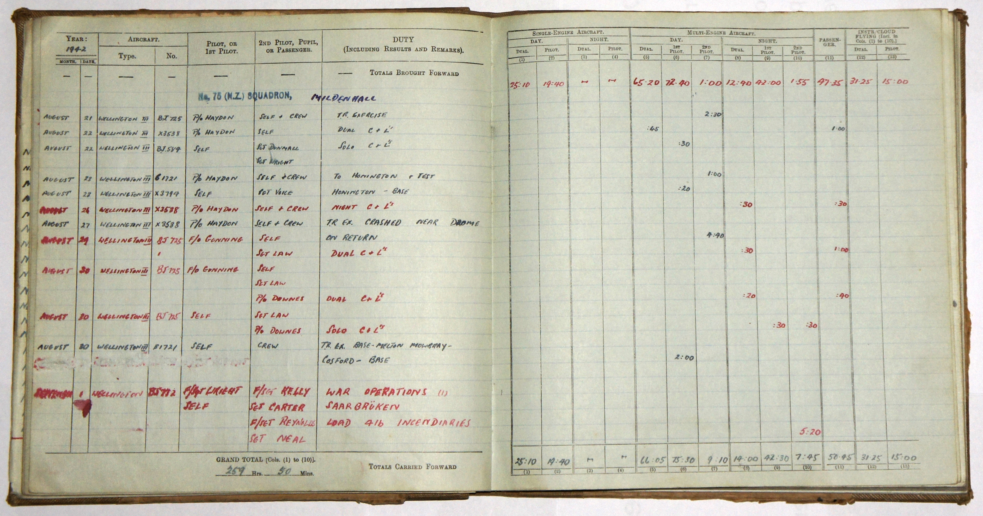

Slide 4
If We Want to Carry Data

Slide 5
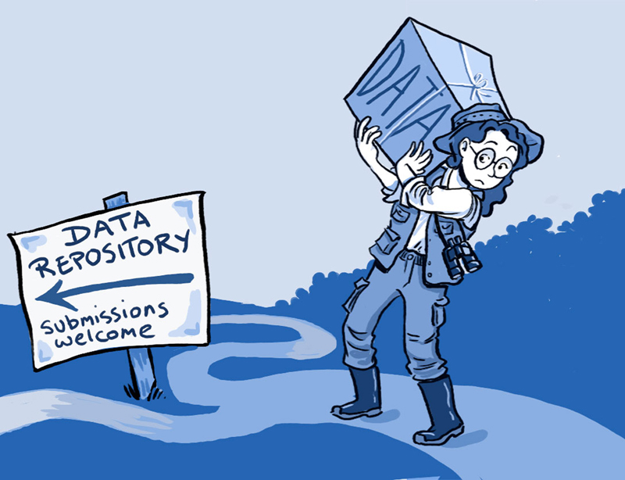


Slide 6
Now a Days

Slide 7



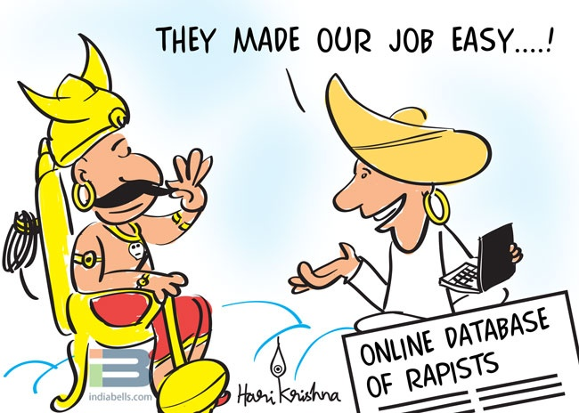



Slide 8
Company Servers

Slide 9
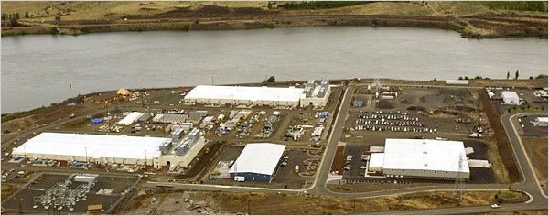




Slide 10
Databases @ Present

Slide 11





Some Databases

Slide 12

Let’s Get Started SQLite

Slide 13
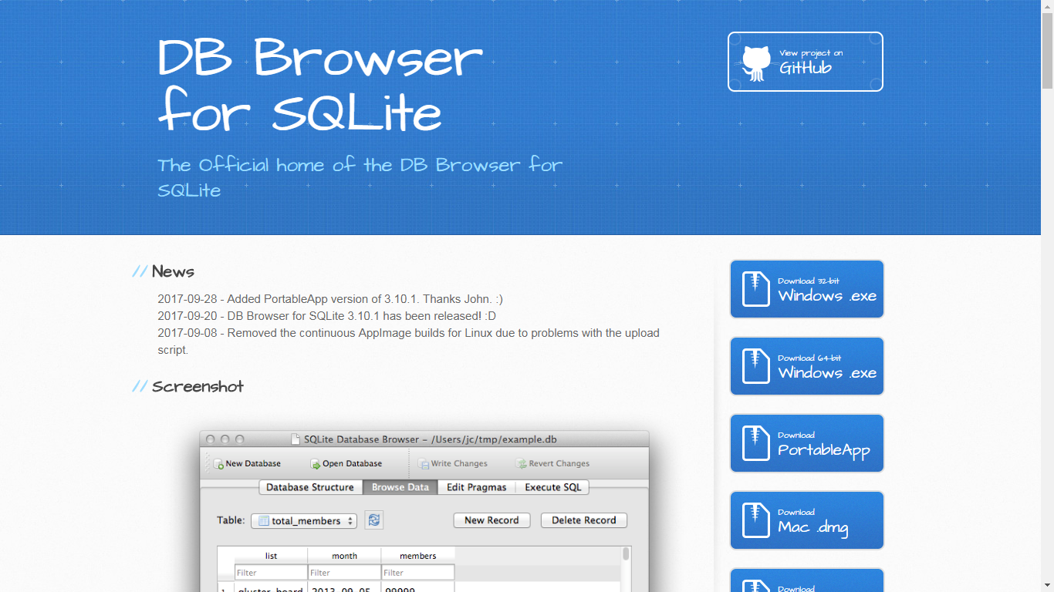
SQLite Browser Download :
Url :
http://sqlitebrowser.org/

Slide 14
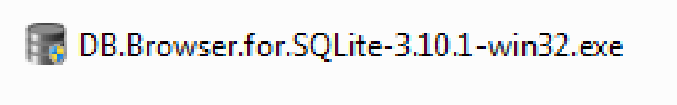
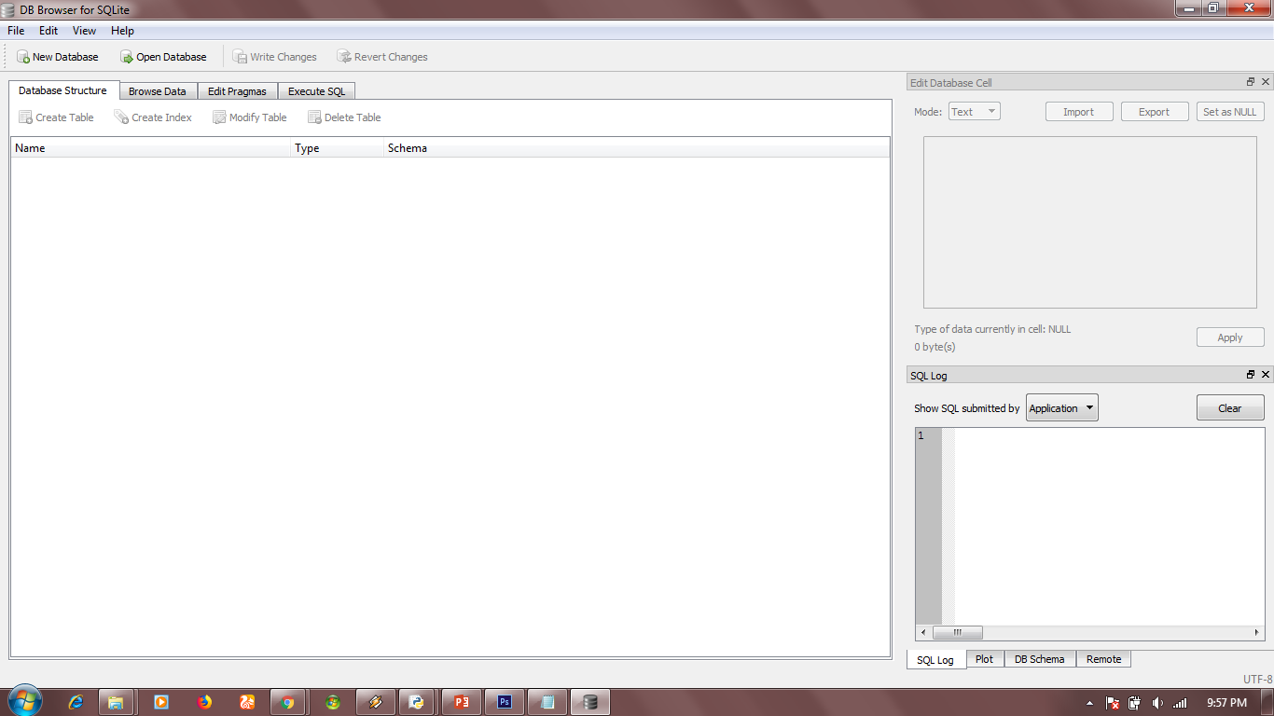
- Install it

Slide 15

SQLite + Python

Slide 16
CRUD Operations
C -
Create
Retrieve
R -
Update
U -
Delete
D -

Slide 17
Data Types in SQLiteBrowser
1. INTEGER
2. TEXT
3. BLOB(Binary Large OBject)
4. REAL
5. NUMERIC

Slide 18
Queries
Creating Table :
Syntax :
-------------
Create table table_name(column_name datatype key,
column_name datatype);
Example :
--------------
Create table student(id Text primary key, name text, branch text)

Slide 19
Queries
Inserting Values in Table :
Syntax:
------------
Insert into table_name values(value1,value2, value3);
Example:
--------------
Insert into student values(’14BF5A0509’,’Vinod’, ’Civil’);

Slide 20
Queries
Retrieving the Table Values :
Syntax:
------------
Select * from table_name;
Example:
--------------
Select * from student;

Slide 21
Queries
Updating Values in Table :
Syntax:
------------
Update table_name set column=‘New Value’ where column=‘value’;
Example:
--------------
Update student set name=‘Vinod P’ where id=‘14BF5A0509’;

Slide 22
Queries
Deleting Value from a Row :
Syntax:
------------
Delete from table_name where column=‘value’;
Example:
--------------
Delete from student where id=‘14BF5A0509’;

